Slide 1
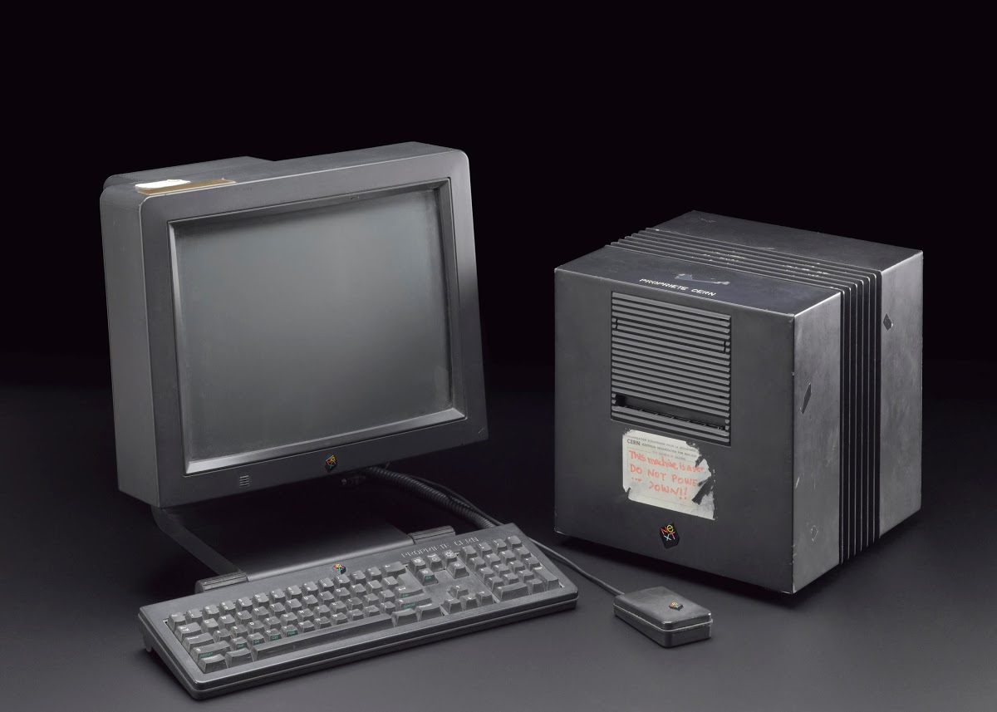
react.net

Slide 2

overview
web languages
browser DOM (not important)
react (pretty important) & jsx
NB: everything is interactive
it looks like you're trying to make a winforms app

Slide 3
1. web languages
html
static content
e.g. headings, paragraphs, tables, bullet lists, etvc
javascript
dynamic content
e.g. dropdown lists, tooltips on hover, etc
css
styling
🤮

Slide 4

html
<!DOCTYPE html>
<html>
<body>
<h1>hello world</h1>
</body>
</html>

Slide 5
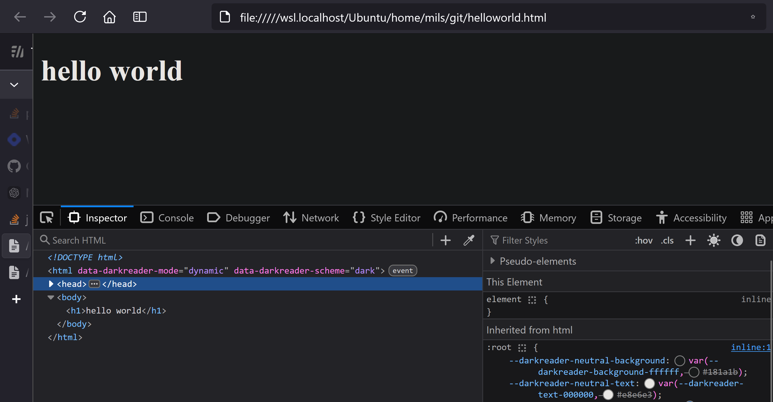
html

Slide 6
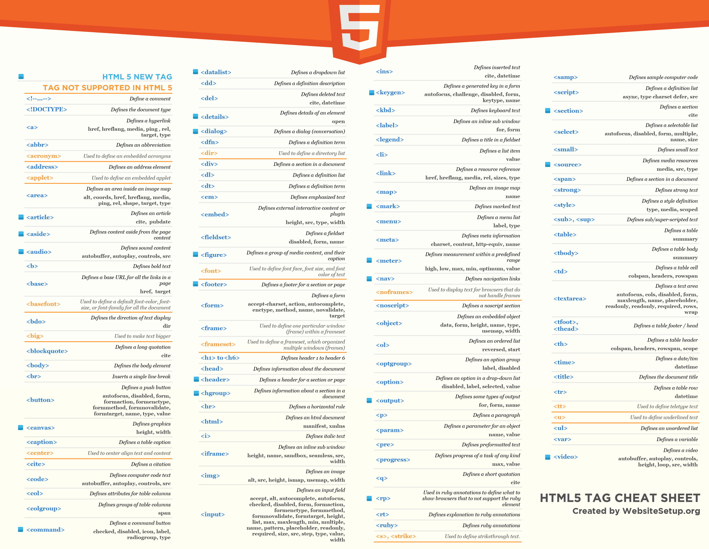

Slide 7
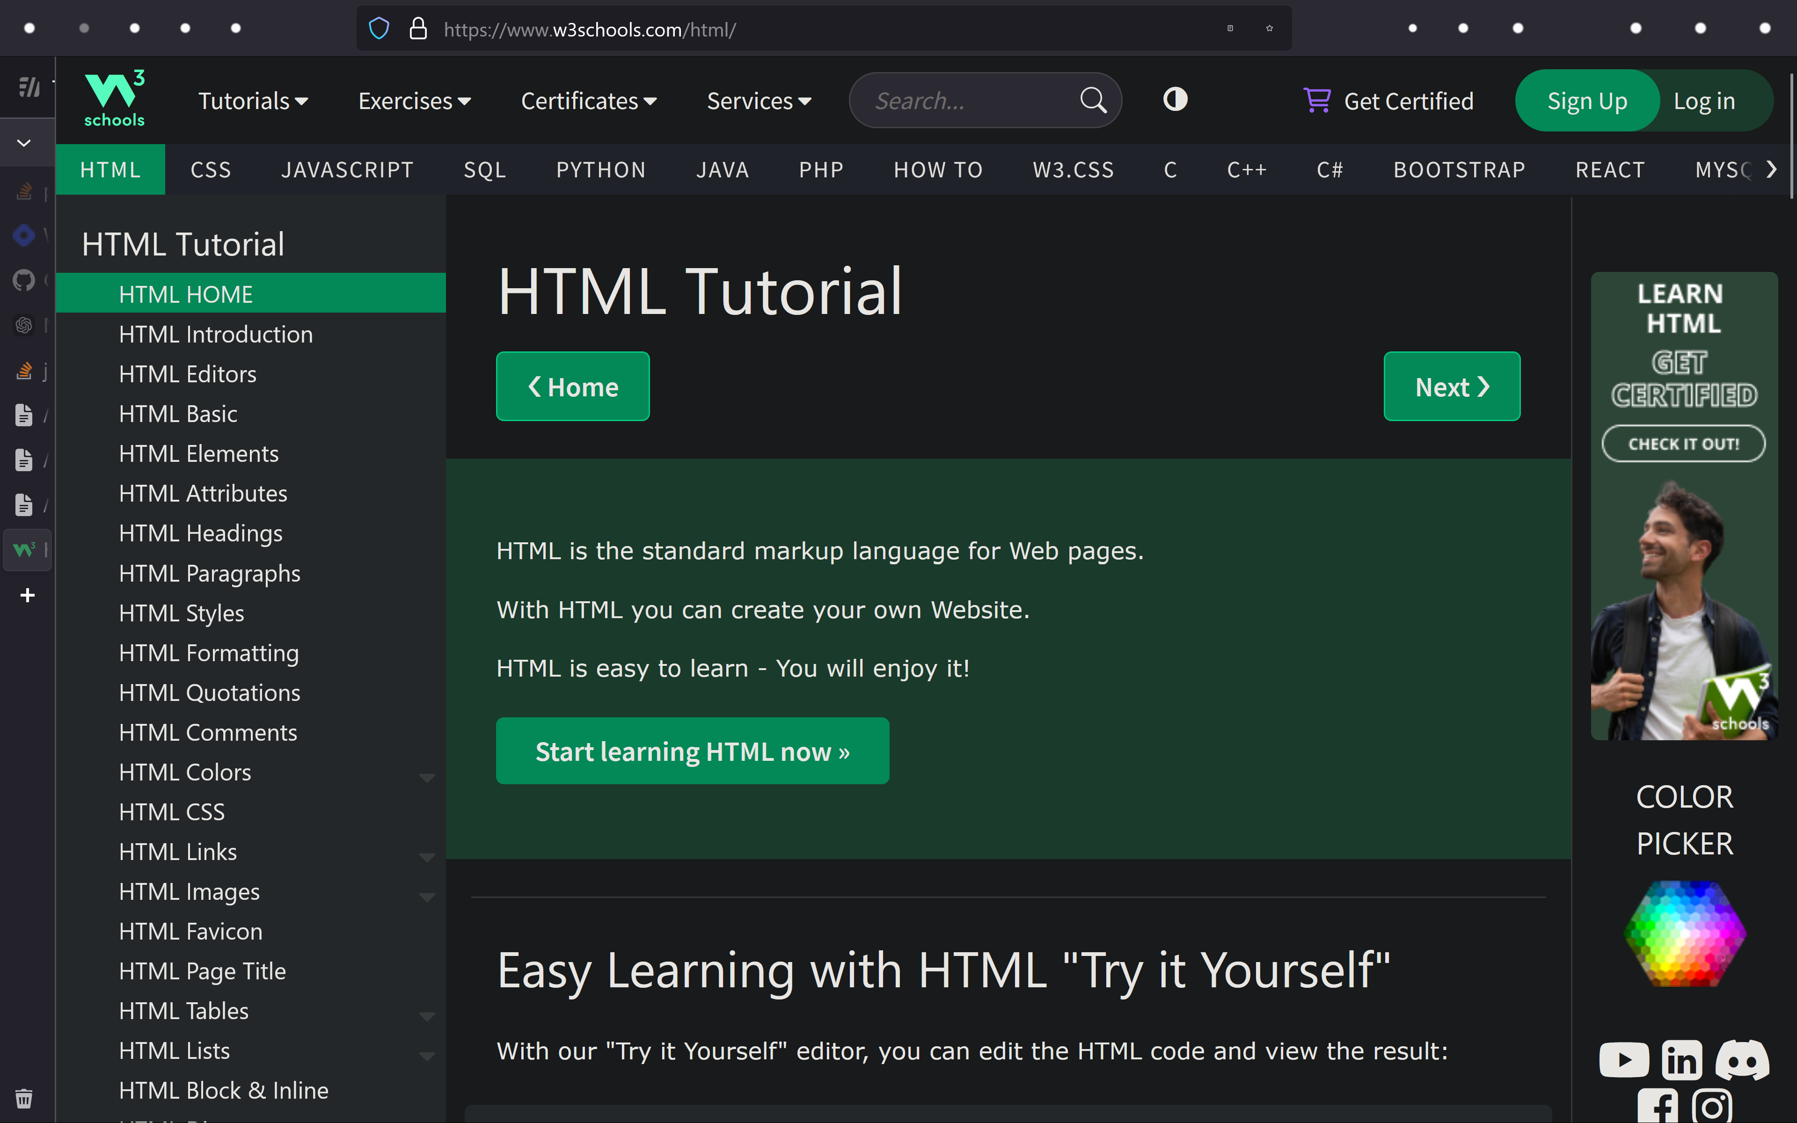

Slide 9

<!DOCTYPE html>
<html>
<body>
<h1>hello world</h1>
</body>
</html>

Slide 10
javascript
<!DOCTYPE html>
<html>
<body>
<h1 id="magic">hello world</h1>
<button
type="button"
onclick='document.getElementById("magic").innerHTML = "goodbye world!"'>
Click Me!
</button>
</body>
</html>

Slide 11
javascript
<!DOCTYPE html>
<html>
<body>
<h1 id="magic">hello world</h1>
<button
type="button"
onclick='document.getElementById("magic").innerHTML = "goodbye world!"'>
Click Me!
</button>
</body>
</html>

Slide 12
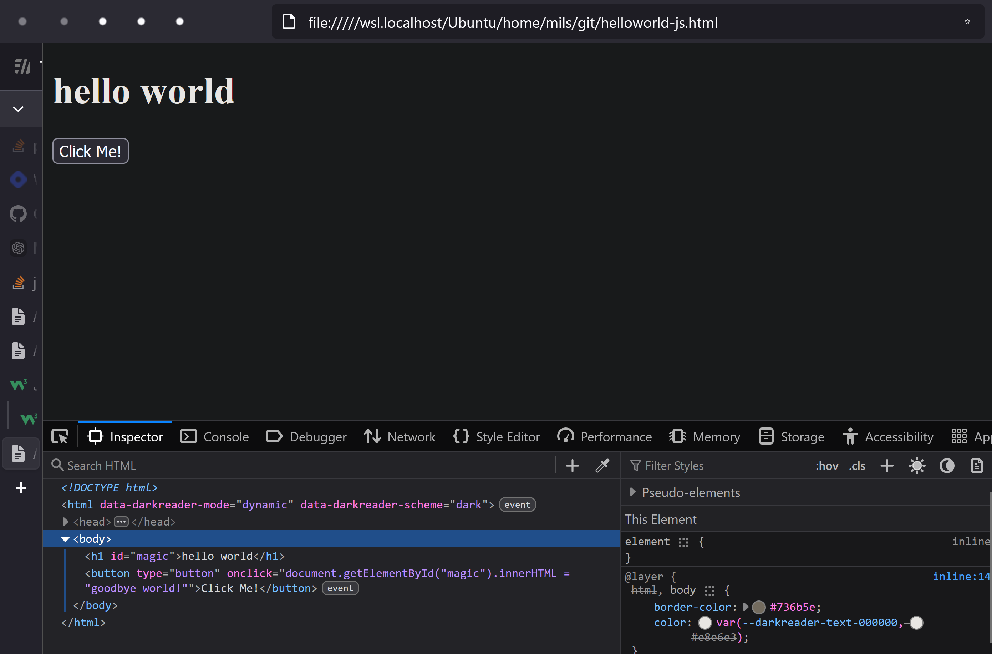
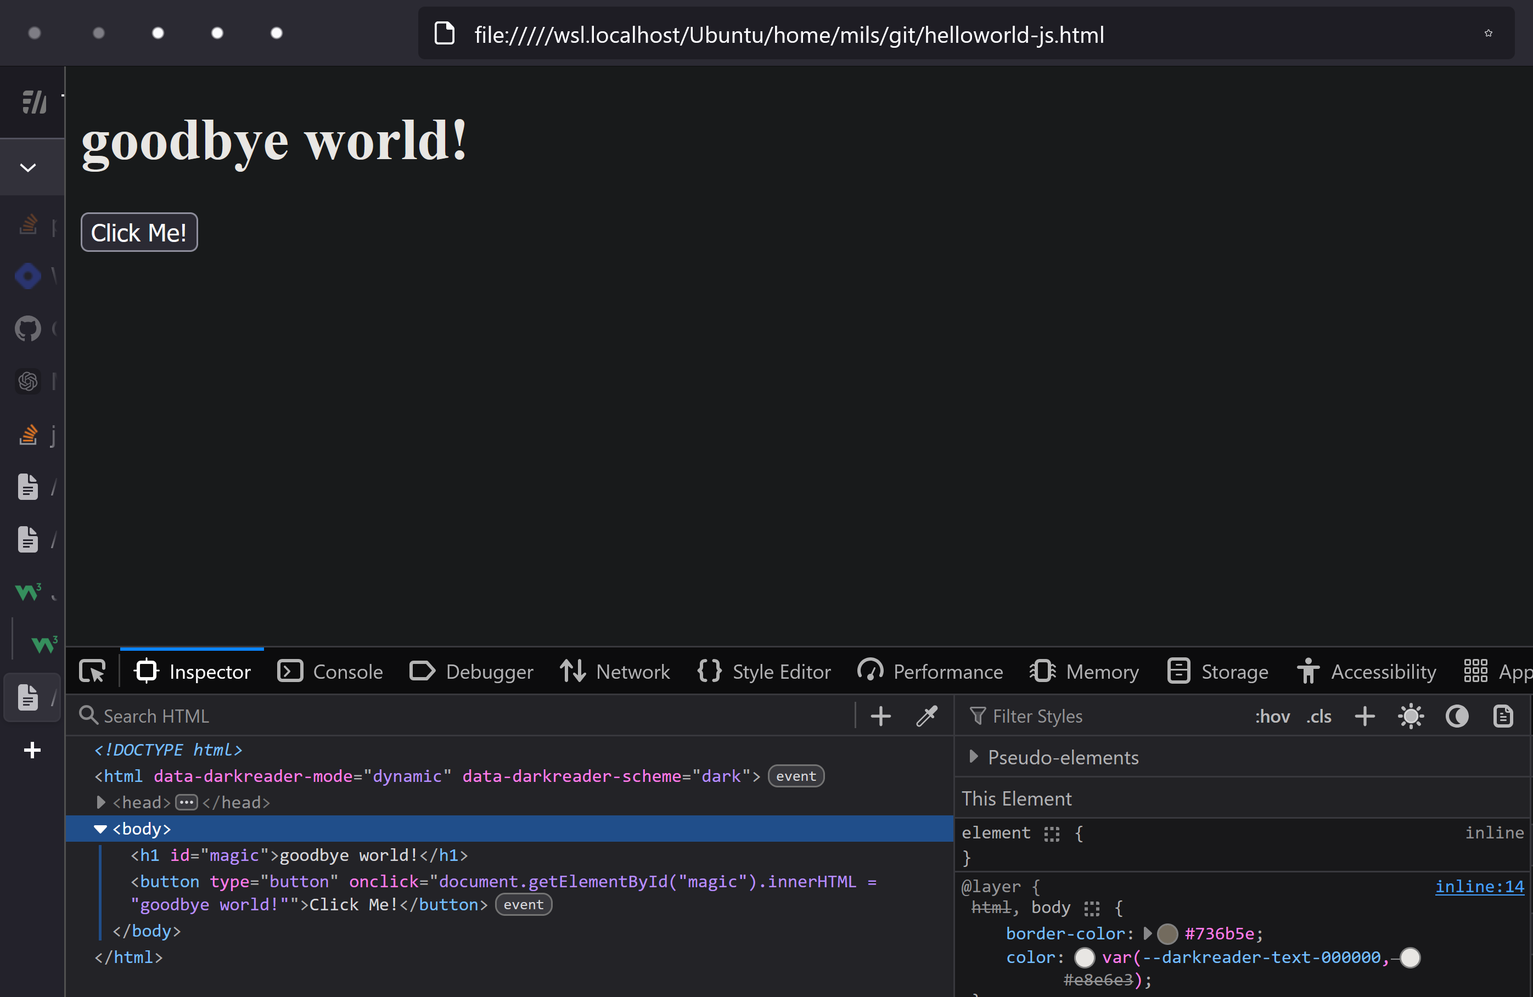
javascript

Slide 13
javascript
<!DOCTYPE html>
<html lang="en">
<body>
<h1>Hello, World!</h1>
<script>
document.querySelector("h1").textContent = "Hello from JavaScript!";
</script>
</body>
</html>

Slide 14
javascript
<!DOCTYPE html>
<html lang="en">
<body>
<h1>Hello, World!</h1>
<script>
document.querySelector("h1").textContent = "Hello from JavaScript!";
</script>
</body>
</html>

Slide 16

css

Slide 17
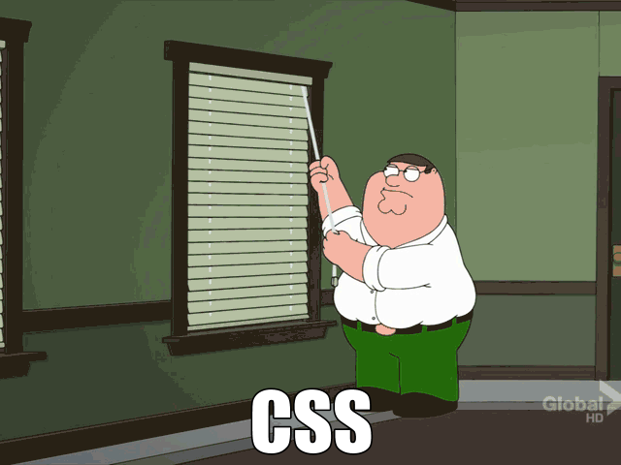
css

Slide 18
css

Slide 19
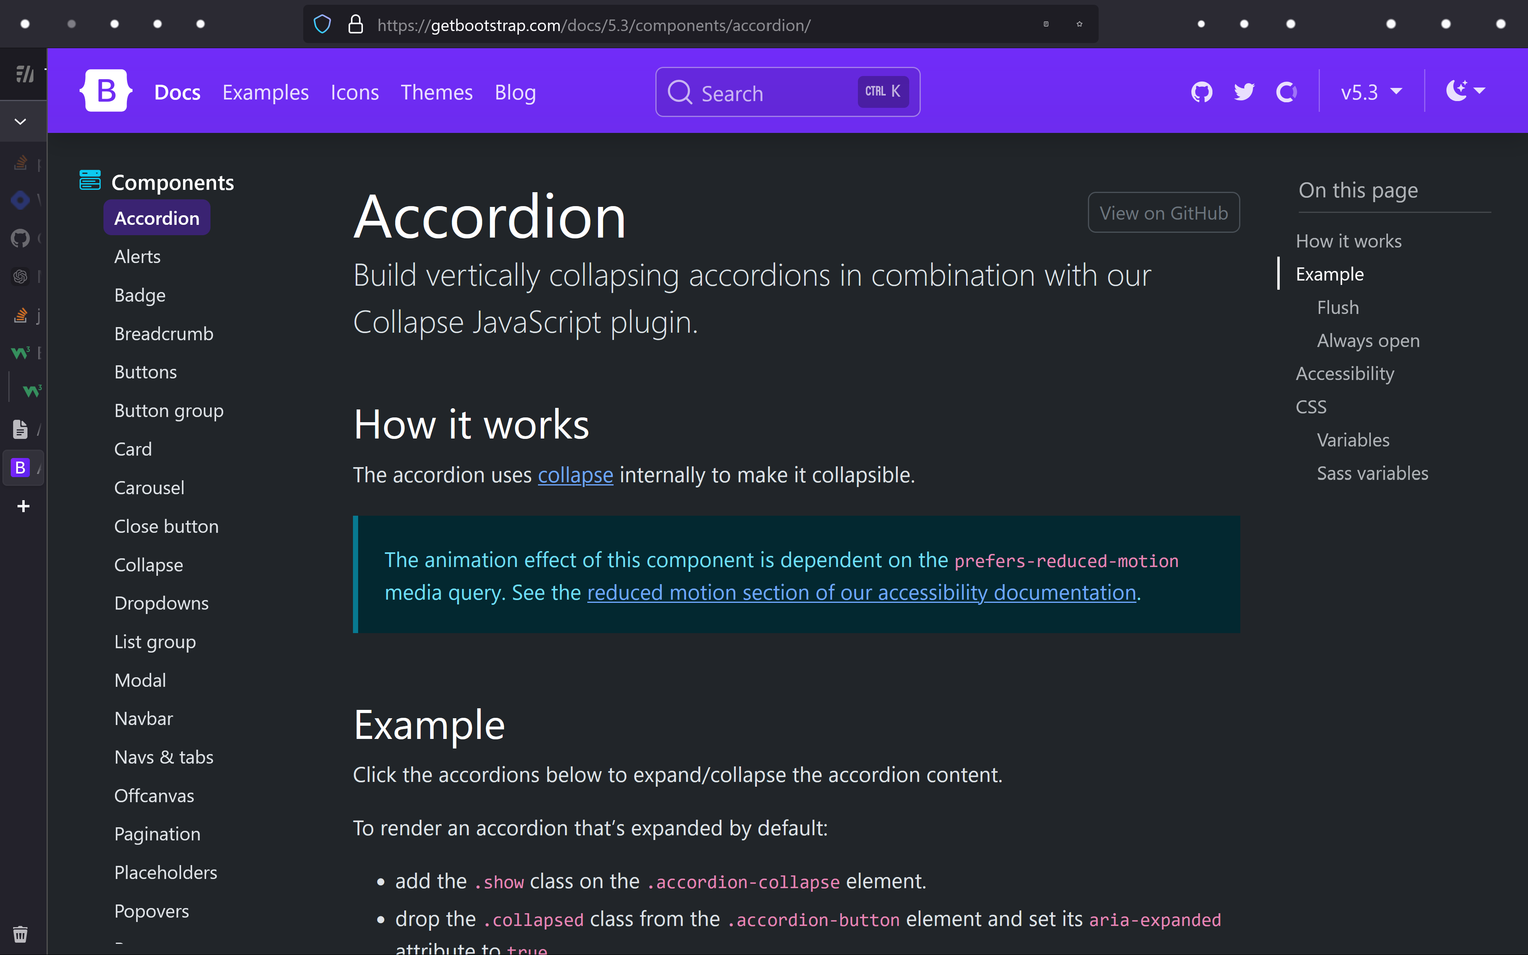

Slide 20
<!DOCTYPE html>
<html>
<body>
<h1 id="magic">hello world</h1>
<button
type="button"
onclick='document.getElementById("magic").innerHTML = "goodbye world!"'>
Click Me!
</button>
</body>
</html>

Slide 21
css
<!DOCTYPE html>
<html>
<head>
<link rel="stylesheet" href="https://maxcdn.bootstrapcdn.com/bootstrap/3.4.1/css/bootstrap.min.css">
<script src="https://ajax.googleapis.com/ajax/libs/jquery/3.7.1/jquery.min.js"></script>
<script src="https://maxcdn.bootstrapcdn.com/bootstrap/3.4.1/js/bootstrap.min.js"></script>
</head>
<body>
<h1 id="magic">hello world</h1>
<button
type="button"
class="btn btn-info"
onclick='document.getElementById("magic").innerHTML = "goodbye world!"'>
Click Me!
</button>
</body>
</html>

Slide 22
css
<!DOCTYPE html>
<html>
<head>
<link rel="stylesheet" href="https://maxcdn.bootstrapcdn.com/bootstrap/3.4.1/css/bootstrap.min.css">
<script src="https://ajax.googleapis.com/ajax/libs/jquery/3.7.1/jquery.min.js"></script>
<script src="https://maxcdn.bootstrapcdn.com/bootstrap/3.4.1/js/bootstrap.min.js"></script>
</head>
<body>
<h1 id="magic">hello world</h1>
<button
type="button"
class="btn btn-info"
onclick='document.getElementById("magic").innerHTML = "goodbye world!"'>
Click Me!
</button>
</body>
</html>

Slide 23
javascript

Slide 24
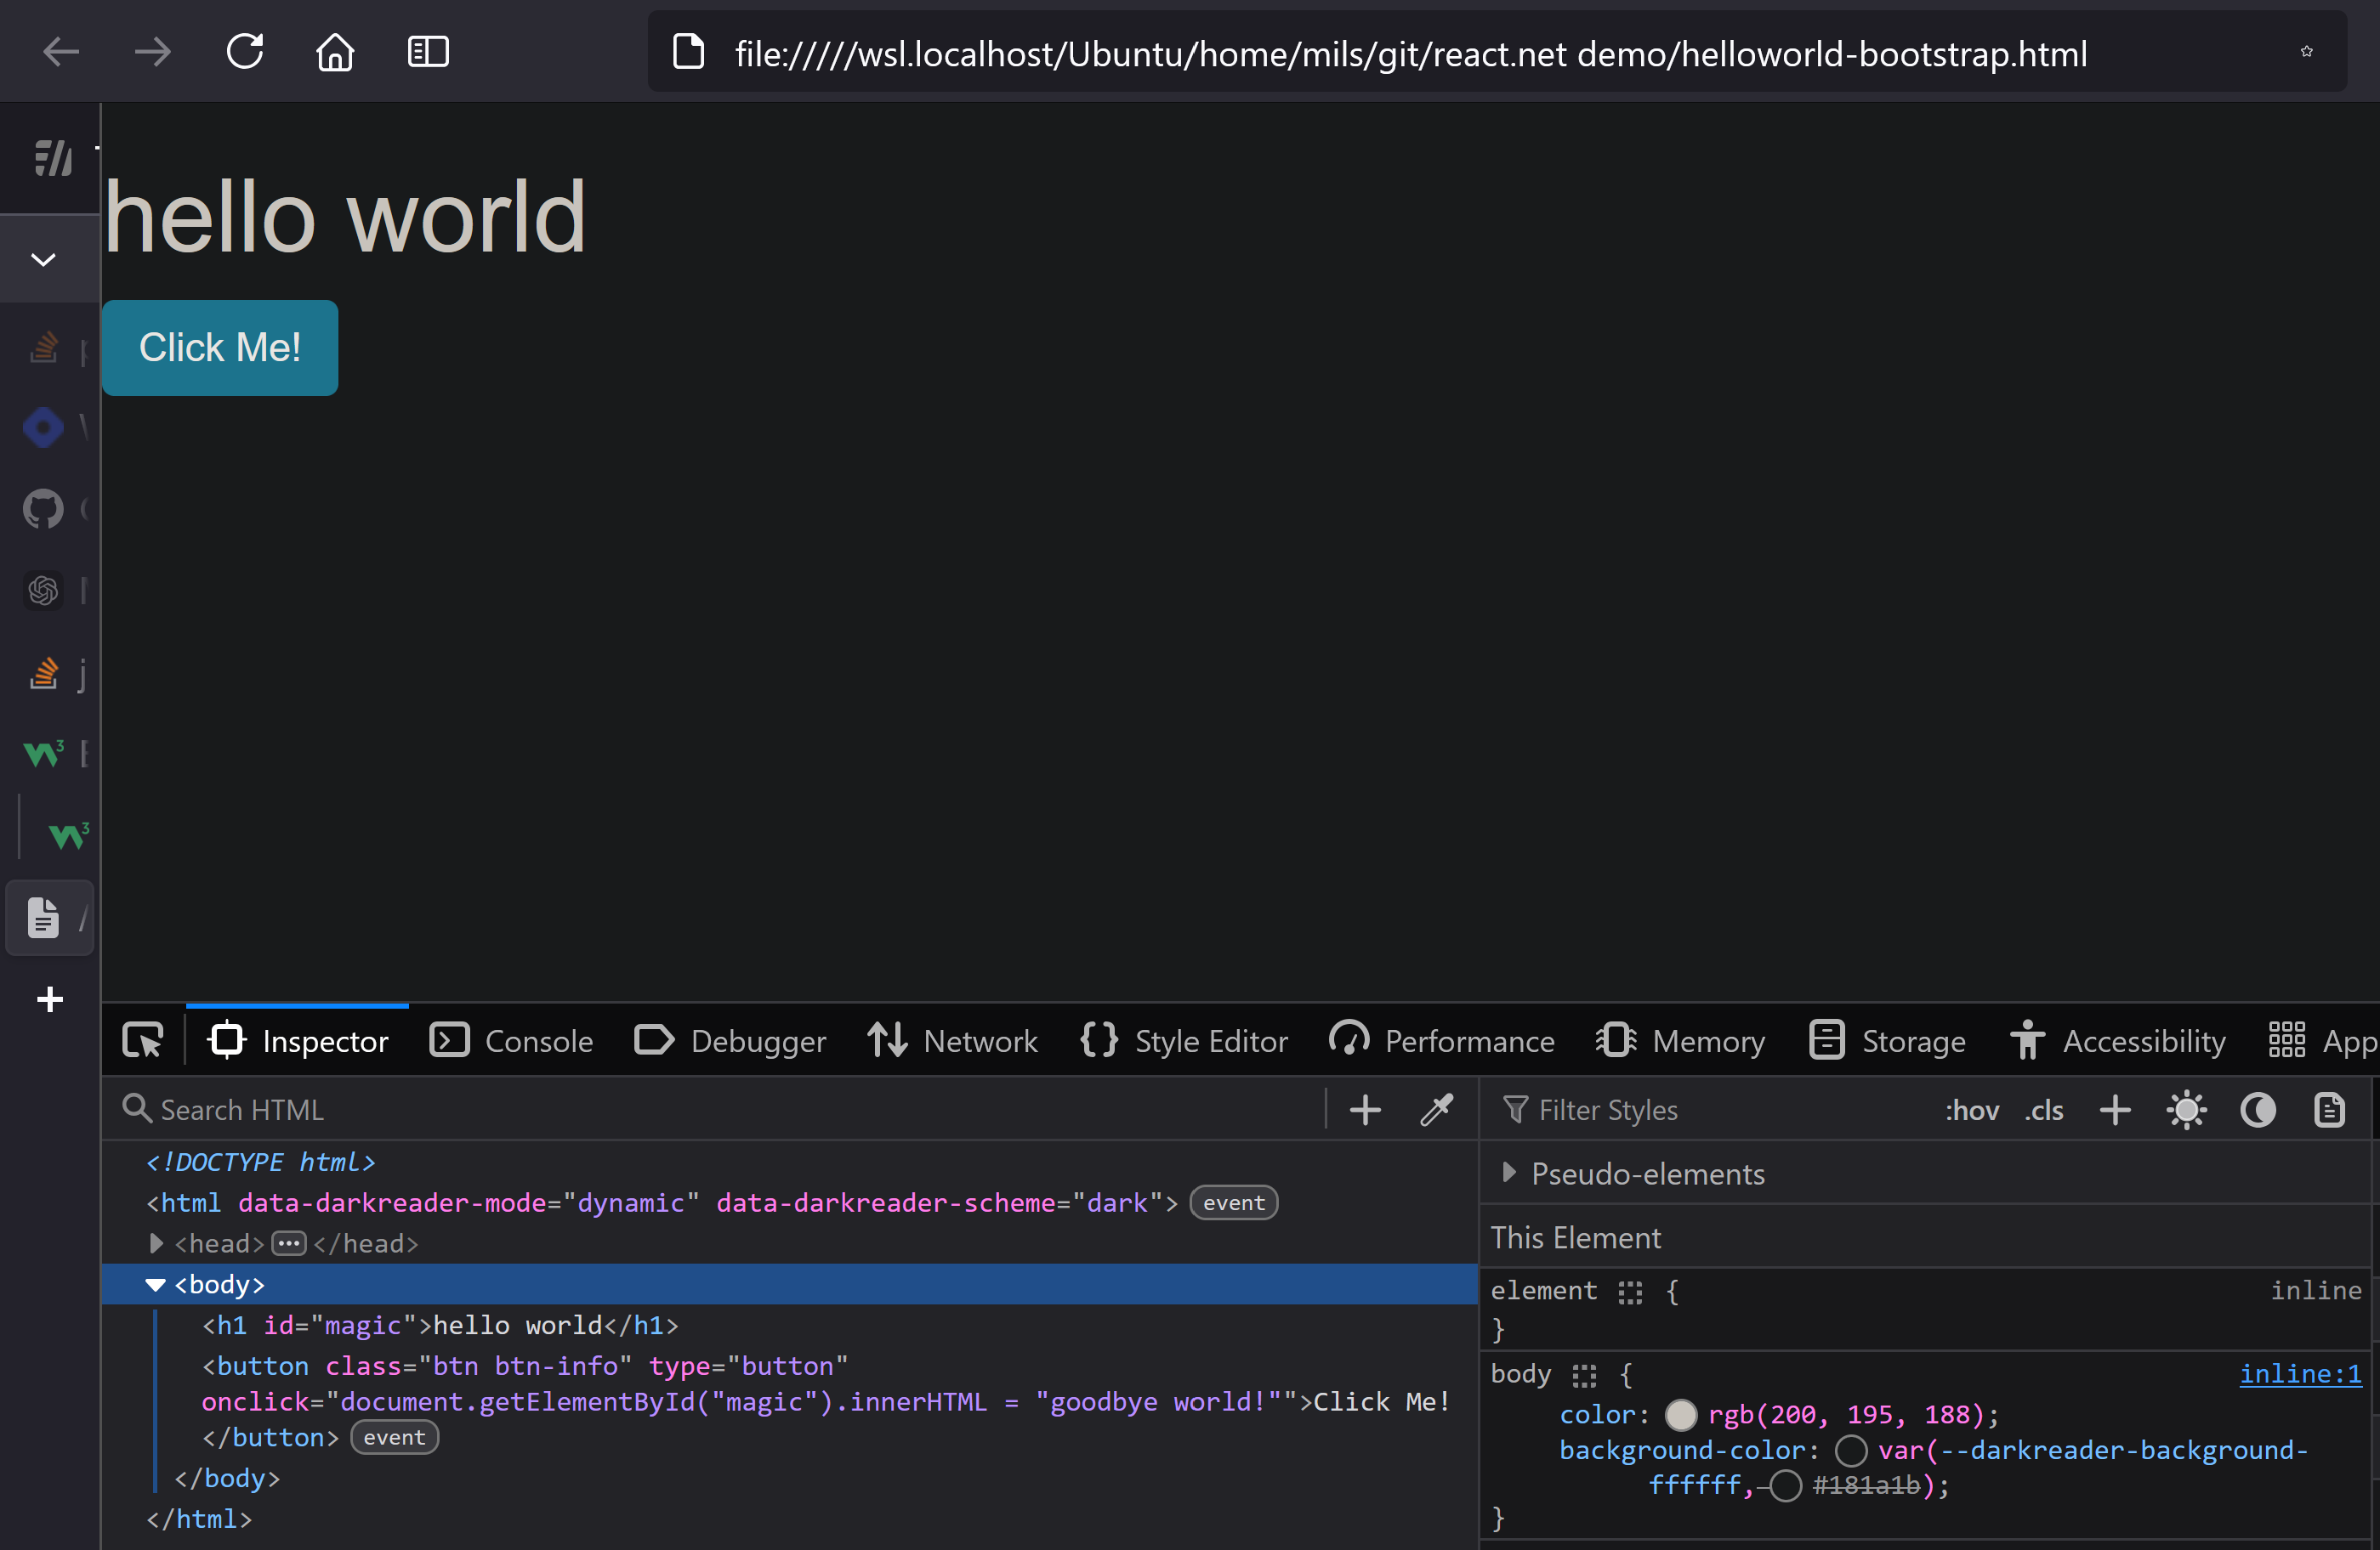

Slide 25

PHONE <select> DEMO PLACEHOLDER

Slide 26

css - the grid
the heart and soul of "responsive" apps
all libraries follow the same pattern:
base-12 grid
customize per screen side (xs, s, m, l, xl)

Slide 27
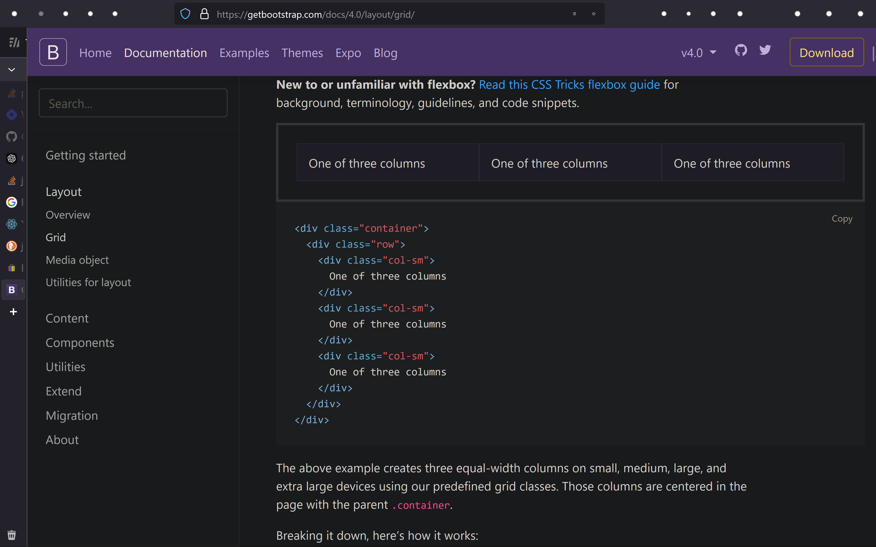
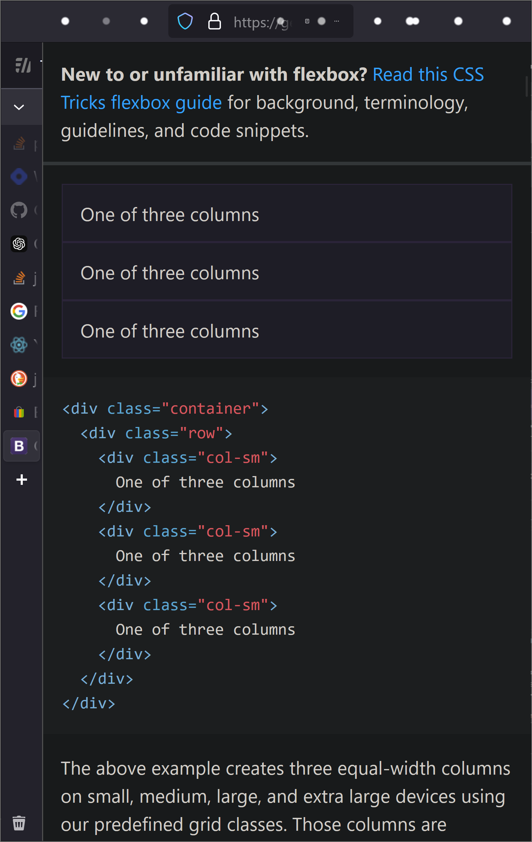
css - the grid
base 12
"for small and up, use columns.
otherwise rows"

Slide 29

DOM
"Domain Object Model"
i.e. OOP

Slide 30
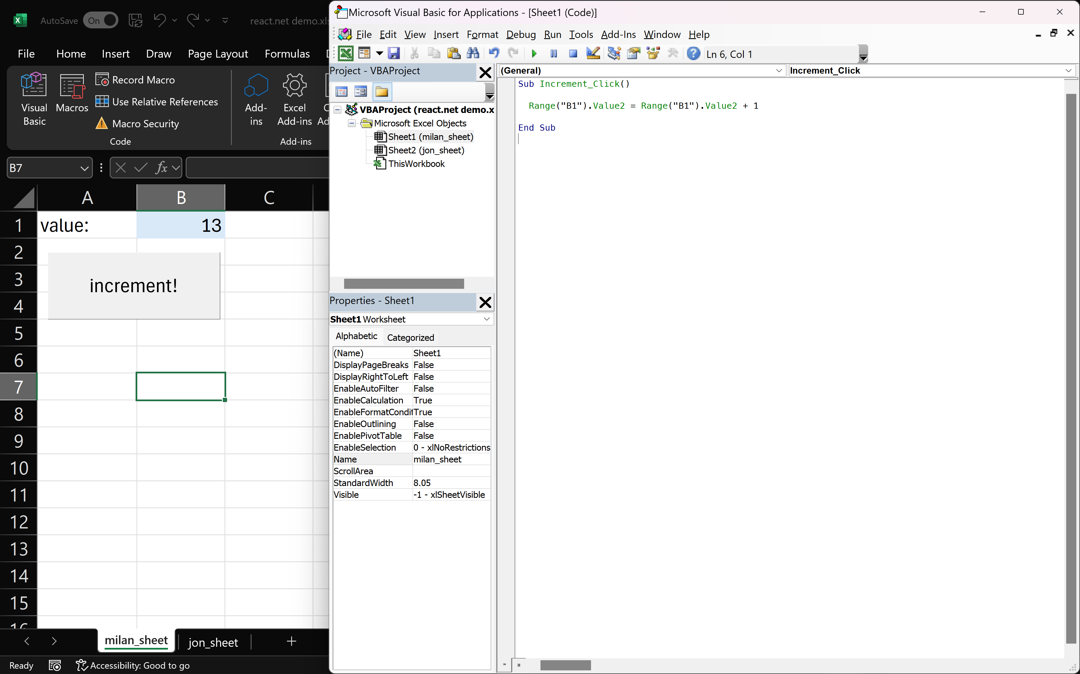
Excel DOM
Excel Domain Object Model

Slide 31
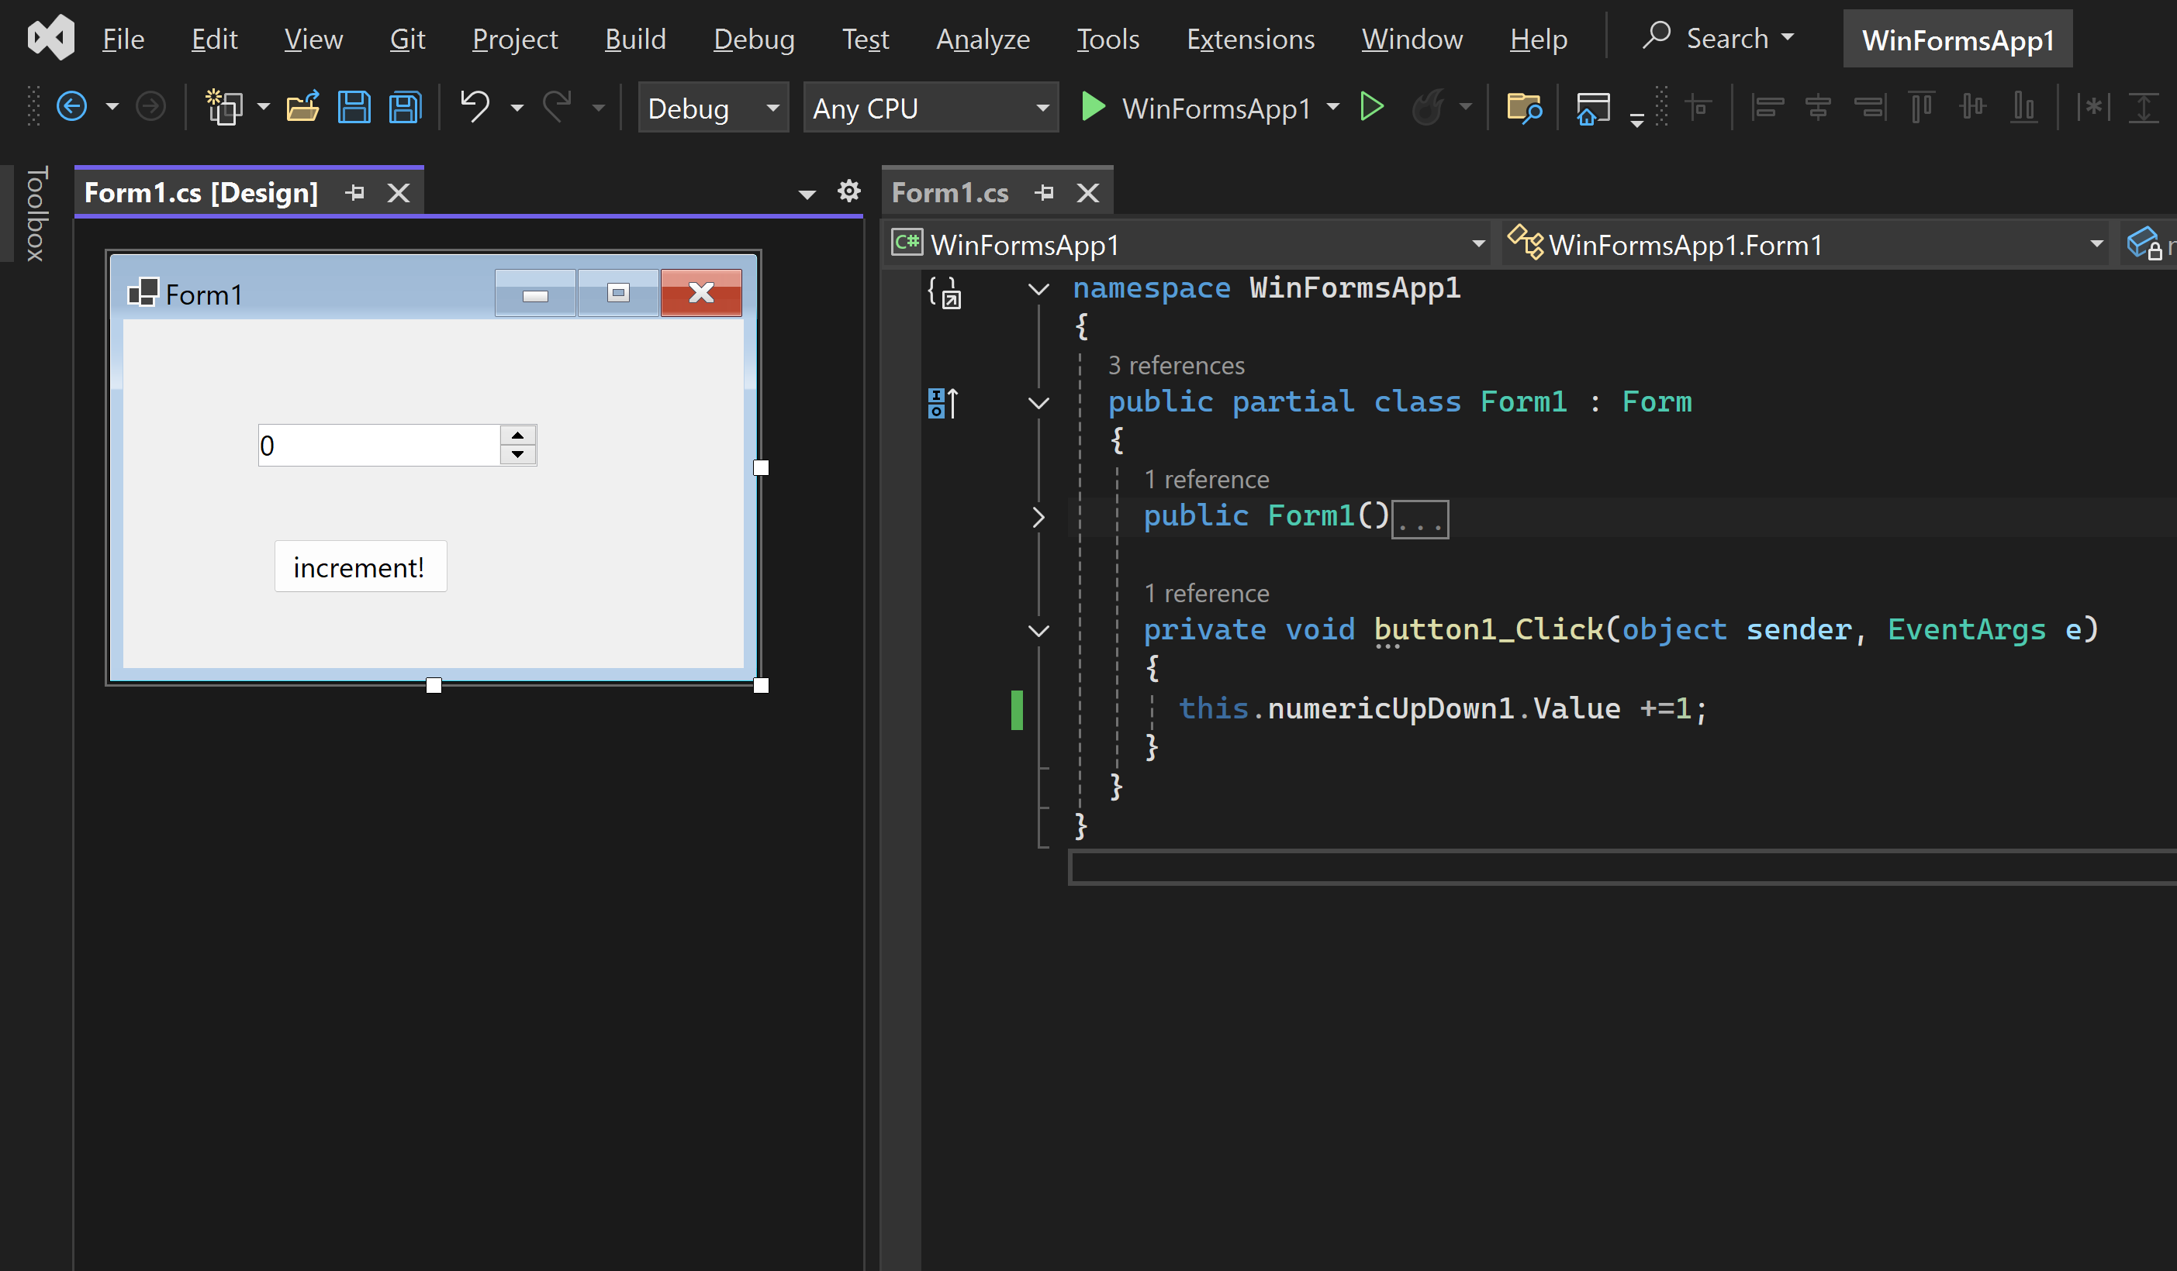
WinForms Domain Object Model

Slide 32
Browser Domain Object Model
<!DOCTYPE html>
<html>
<body>
<h1 id="magic">hello world</h1>
<button
type="button"
onclick='document.getElementById("magic").innerHTML = "goodbye world!"'>
Click Me!
</button>
</body>
</html>

Slide 33
BROWSER DOM DEMO PLACEHOLDER
(live edit, dom tree)

Slide 35

react
overview
jsx
state management
react libraries

Slide 36
react
it's a library (react) and a "templating language" (JSX)
entire web app can be written in javascript
use javascript to write html
far better than templating languages (jinja, etc)
bonus points:
type safety (typescript)
can be deployed as an app
state management
rendering management

Slide 37
react - mvp
<!DOCTYPE html>
<html>
<head>
<script src="https://unpkg.com/react@18.0.0/umd/react.development.js" crossorigin="anonymous"></script>
<script src="https://unpkg.com/react-dom@18.0.0/umd/react-dom.development.js" crossorigin="anonymous"></script>
</head>
<body>
<div id="root"></div>
<script>
ReactDOM.render(
React.createElement('h1', null, "Hello world"),
document.getElementById('root')
);
</script>
</body>
</html>

Slide 38
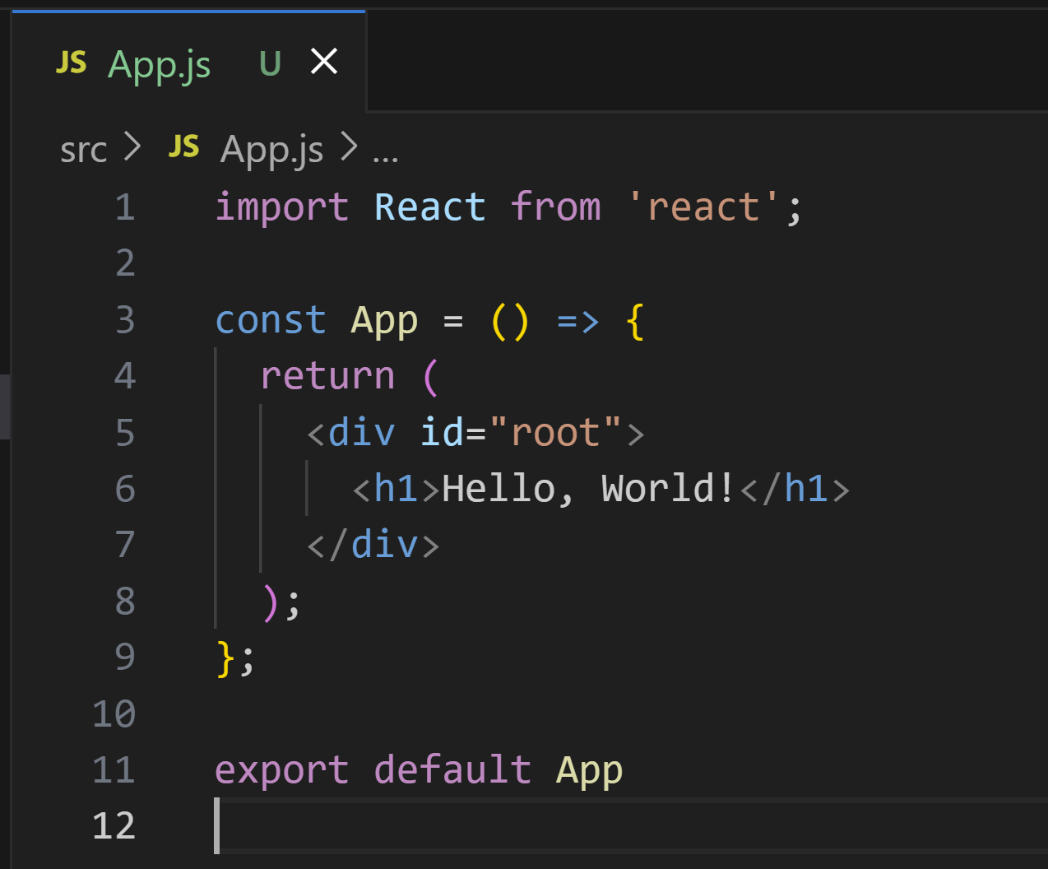


react with jsx - mvp

Slide 39
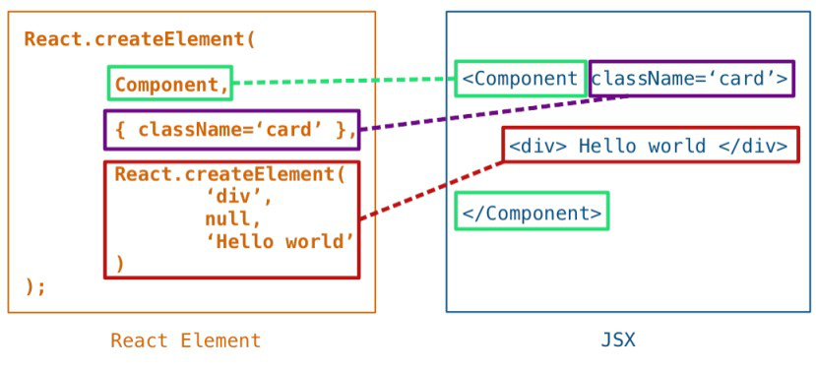
JSX

Slide 40
WinForms Domain Object Model

Slide 41
import React, { useState } from 'react';
const App = () => {
// Initialize the counter state to 0
const [counter, setCounter] = useState(0);
// Function to increment the counter
const incrementCounter = () => {
setCounter(counter + 1);
};
return (
<div>
<h1>Hello, World!</h1>
<p>{counter}</p>
<button onClick={incrementCounter}>Increment!</button>
</div>
);
};
export default App

Slide 42
state management
useState
useEffect
--------------------------
redux / zustand / etc
and more!

Slide 43
import React, { useState } from 'react';
const App = () => {
// Initialize the counter state to 0
const [counter, setCounter] = useState(0);
// Function to increment the counter
const incrementCounter = () => {
setCounter(counter + 1);
};
return (
<div>
<h1>Hello, World!</h1>
<p>{counter}</p>
<button onClick={incrementCounter}>Increment!</button>
</div>
);
};
export default App
auto-property

Slide 44
useEffect

Slide 45

import React, { useState, useEffect } from 'react'
function SearchResults() {
const [searchTerm, setSearchTerm] = useState('')
const [results, setResults] = useState([])
useEffect(() => {
if (searchTerm) {
fetch(`https://jsonplaceholder.typicode.com/todos/1?q=${searchTerm}`)
.then(response => response.json())
.then(setResults(Math.random()))
}
}, [searchTerm]) // Re-run effect when searchTerm changes
return (
<div>
<input
type="text"
value={searchTerm}
onChange={e => setSearchTerm(e.target.value)}
/>
<p>{results}</p>
</div>
);
}
export default SearchResults
Let’s say you have a search term, and you want to fetch data from an API whenever the search term changes.
useEffect + useState !

Slide 46
demo

Slide 47
demo - tools
nvm (node version manager)
reads `.nvmrc`
node (runtime)
npm (node package manager)
reads `package.json` and `package-lock.json`
creates `./node_modules/`
can call binaries in `./node_modules/bin/`
webpack (bundler)
reads `webpack.config.js`
babel (transpiler)
reads `.babelrc`

Slide 48
react libraries
styled-components
react-router
electron

Slide 49
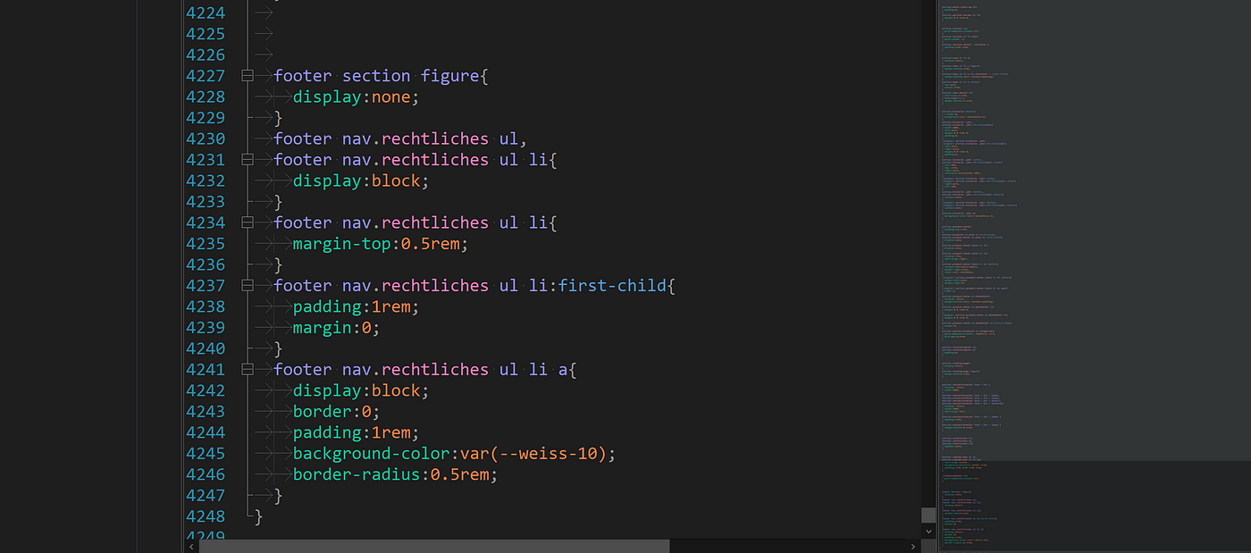
styled-components

Slide 50
styled-components
import React from 'react';
import styled from 'styled-components';
const Button = styled.button`
background-color: #4CAF50;
color: white;
font-size: 16px;
padding: 10px 20px;
cursor: pointer;
`;
const App = () => {
return (
<div>
<h1>Styled Components Example</h1>
<Button>Click Me!</Button>
</div>
);
};
export default App;

Slide 51
react-router
playbook screenshot

Slide 52
react-router
import React from 'react';
import { BrowserRouter as Router, Route, Switch, Link } from 'react-router-dom';
import Home from './Home';
import About from './About';
import Contact from './Contact';
const App = () => {
return (
<Router>
<div>
<nav>
<ul>
<li><Link to="/">Home</Link></li>
<li><Link to="/about">About</Link></li>
<li><Link to="/contact">Contact</Link></li>
</ul>
</nav>
<Switch>
<Route path="/" exact component={Home} />
<Route path="/about" component={About} />
<Route path="/contact" component={Contact} />
</Switch>
</div>
</Router>
);
};
export default App;

Slide 53
electron.js
html, css, js, dom, react
nvm, node, npm, webpack, babel
useState, useEffect, react-router
css grid, styled components
electron.js

Slide 54
electron.js
html, css, js, dom, react
nvm, node, npm, webpack, babel
useState, useEffect, react-router
css grid, styled components
electron.js

Slide 55
electron.js
DEMO

Slide 56
References
links to client & playbook repos

